Slide 1
Ignition Envelope Anomaly Detection
Utilizing the Envelope Anomaly Detection System in Ignition

Slide 2
Contents
1 How it works 3–8
2 Implementation 9–20
Overview 3
Creating the UDT 9–11
Detection Flow 4
Creating the Logic Scripts 12
What this system overcomes 5
Creating the Timer Scripts 13–15
Window Logic 6–8
Alarm Configuration 16–19
Adding Another Servo 20
Stage 1: Sample-level rolling window 6
Stage 2: Rolling 60-minute notification 7
3 Reporting 21–25
Stage 3: Fixed clock-hour reporting 8
Reporting Overview 21
Current Day & Week to Date Reports 22–23
Daily & Weekly Reports 24–25

Slide 3
Overview
This project implements reusable operational-envelope anomaly detection for servo tags in Ignition.
The implementation consists of:
1. A reusable User-Defined Type (UDT)
2. A Gateway Timer Script
3. A Project Library evaluator
4. Two separate alarm outputs
5. A dedicated Alarm Journal
6. Current-day, completed-day, and weekly reporting functions

Slide 4
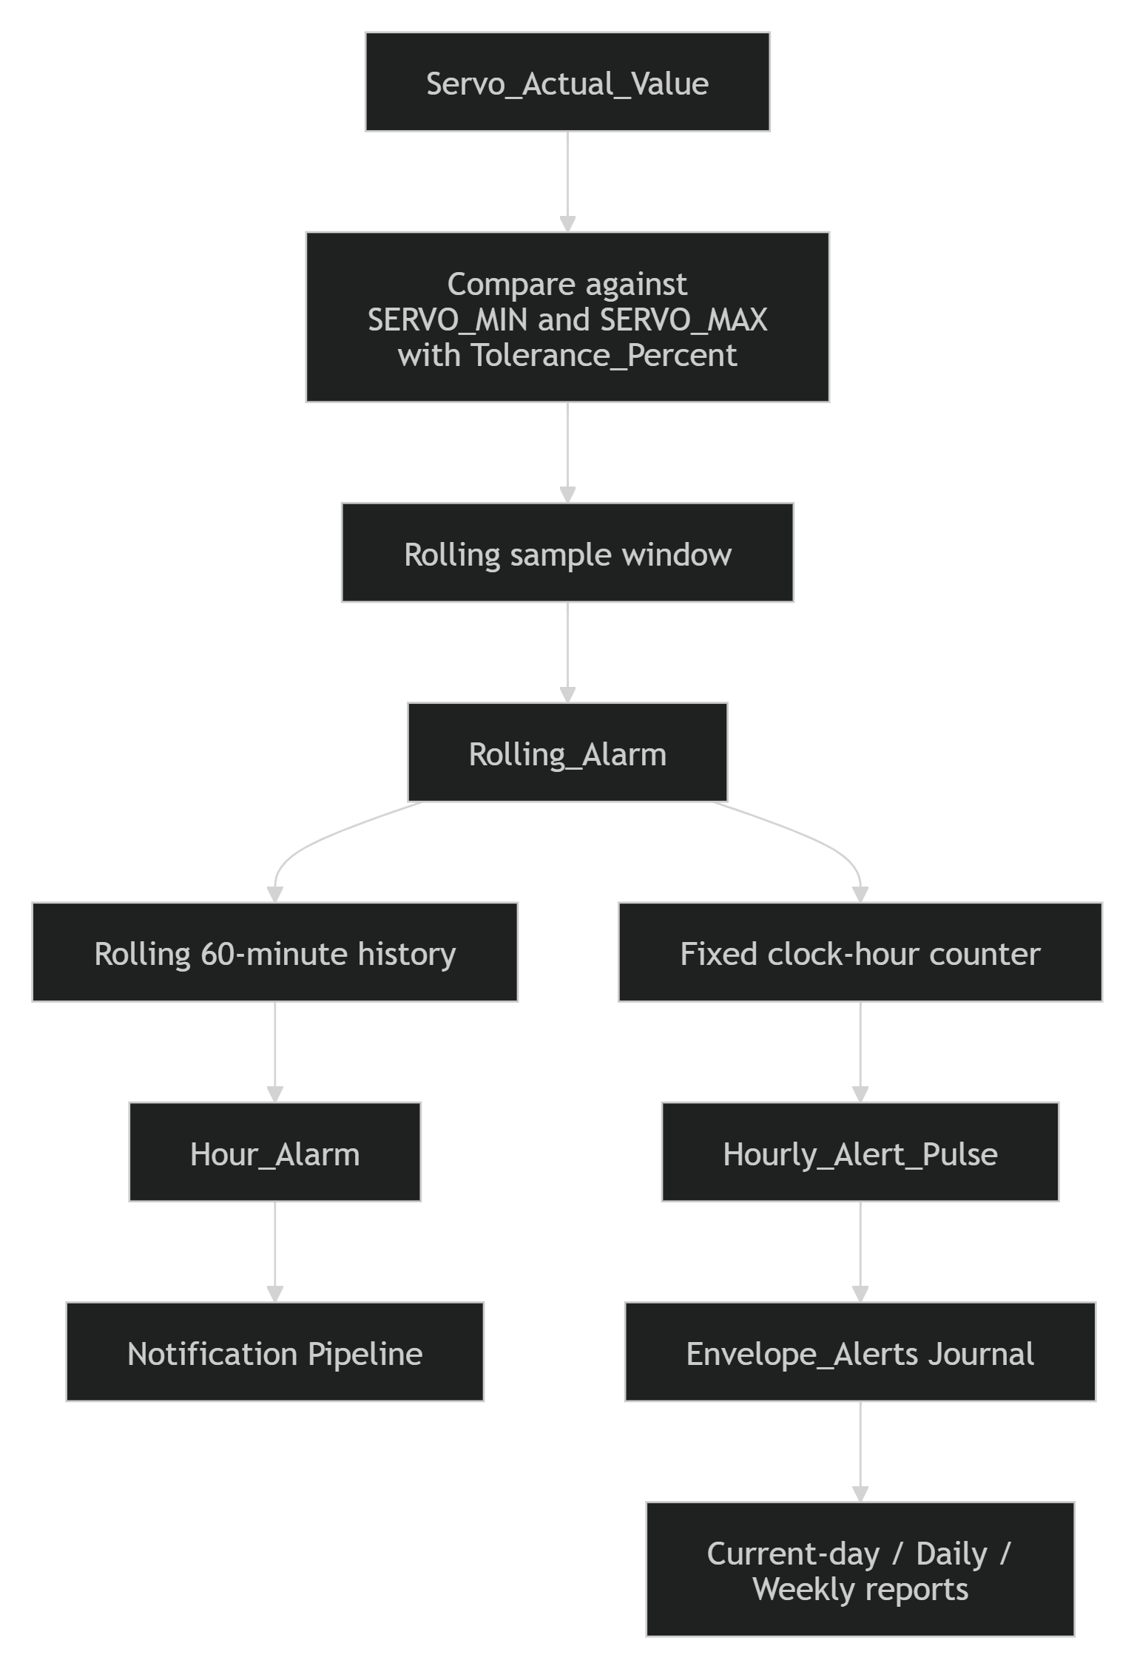
Detection Flow
Monitor: Capture the live servo value.
Evaluate: Compare it with the configured minimum and maximum operating limits.
Validate: Use a rolling sample window to confirm that the deviation is sustained.
Notify: Evaluate the rolling 60-minute history and trigger the notification pipeline when alarm conditions are met.
Record: Generate one journal event for each fixed clock hour containing an anomaly.
Report: Summarize journaled events in current-day, daily, and weekly reports.

Slide 5
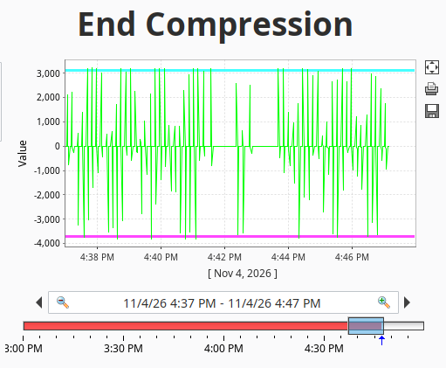
What this system Overcomes
What makes automatically monitoring feedback a challenge?
Servo feedback data is not linear
Values do not remain outside an envelope for longer than a second at a time
A single spike is rarely enough to raise an alarm
Data must stay on-prem and be rapidly available
What constitutes an anomaly?
Consistently jumping outside of the envelope
Multiple, frequent spikes over a sustained period
What do we do?
Build our system within Ignition
Utilize a rolling window system to detect anomalies
Example of torque feedback data that presents challenges for automatic monitoring

Slide 6
Window Logic
Stage 1: Sample-level rolling window
To overcome the challenges of monitoring servo feedback data we use a multistage system of window logic
Sampling
The evaluator samples the servo at the Gateway Timer interval and records whether each evaluation is outside the effective operational envelope.
window size = Window_Seconds / Sample_Interval_Seconds
Effective limits
tolerance = (SERVO_MAX - SERVO_MIN) * Tolerance_Percent
effective minimum = SERVO_MIN - tolerance
effective maximum = SERVO_MAX + tolerance
Alarm condition
Rolling_Alarm is true when the completed sample window contains at least Min_Outside_Samples outside evaluations.

Slide 7
Window Logic
Stage 2: Rolling 60-Minute Notification Condition
History
One Boolean result is retained for each completed minute. The latest 60 completed minute results are stored in Hour_History.
Alarm condition
Hour_Alarm becomes true when the rolling 60-minute history contains at least Min_Alert_Minutes abnormal minutes.
Notification
The alarm on Hour_Alarm may use an Active Pipeline for immediate notification.

Slide 8
Window Logic
Stage 3: Fixed clock-hour reporting event
Hour count
Current_Hour_Outside_Count counts abnormal completed minutes within the current fixed clock hour. Last_Hour_Key identifies the hour currently being accumulated.
Hour boundary
At each clock-hour boundary, the evaluator compares the completed hour count with Min_Alert_Minutes. If the completed hour qualifies, Hourly_Alert_Pulse becomes true for one Gateway Timer execution and then returns to false.
Alarm Journal
This creates one distinct Alarm Journal activation per qualifying clock hour, including consecutive anomaly hours, without sending a notification every hour.

Slide 9
Creating the UDT
The first step to implementing the envelope detection system is creating the anomaly detector UDT. The UDT should be made with the following Tags
Name | Tag Type | Data Type | Default | Purpose
Servo_Actual_Value | Expression or Reference | Numeric | N/A | Monitored servo value. Each UDT instance points this member to the appropriate source tag.
SERVO_MIN | Memory | Numeric | -1 | Lower operational-envelope limit.
SERVO_MAX | Memory | Numeric | 1 | Upper operational-envelope limit.
Tolerance_Percent | Memory | Float | 0 | Additional tolerance applied outside the configured envelope. Use 0.01 for 1%.
Window_Seconds | Memory | Integer | 60 | Duration of the sample-level rolling window.
Sample_Interval_Seconds | Memory | Float | 1 | Evaluator interval in seconds. This must match the Gateway Timer delay.

Slide 10
Creating the UDT (cont.)
Name | Tag Type | Data Type | Default | Purpose
Min_Outside_Samples | Memory | Integer | Site-specific | Minimum outside samples required to activate Rolling_Alarm.
Outside_History | Memory | String | "" | Comma-separated 0/1 sample results for the short rolling window.
Outside_Count | Memory | Integer | 0 | Number of outside evaluations in Outside_History.
Rolling_Alarm | Memory | Boolean | False | Intermediate sample-window anomaly result.
Last_Minute_Key | Memory | Long | 0 | Identifies the clock minute currently being evaluated.
Last_Minute_Result | Memory | Boolean | False | Retains whether the current minute has experienced Rolling_Alarm.
Hour_History | Memory | String | "" | Latest 60 completed minute results used by the rolling hourly condition.

Slide 11
Creating the UDT (cont.)
Name | Tag Type | Data Type | Default | Purpose
Hour_Outside_Count | Memory | Integer | 0 | Number of abnormal minutes in the rolling 60-minute history.
Min_Alert_Minutes | Memory | Integer | 1 | Minimum abnormal minutes required by both hourly evaluations.
Hour_Alarm | Memory | Boolean | False | Rolling 60-minute condition used for immediate notification.
Current_Hour_Outside_Count | Memory | Integer | 0 | Number of abnormal completed minutes in the current fixed clock hour.
Last_Hour_Key | Memory | Long | 0 | Identifies the fixed clock hour currently being accumulated.
Hourly_Alert_Pulse | Memory | Boolean | False | One-cycle pulse for each qualifying completed clock hour; journal/reporting only.
Detector_Status | Memory | String | "Waiting" | Human-readable evaluator status and diagnostics.

Slide 12
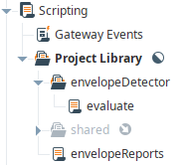
Creating the Logic Scripts
The next step is to create the scripts necessary to drive the detection and generate reports.
Some liberties may be taken in the structure of this as long as function calls are appropriately updated. To utilize the scripts as is use the shown configuration.
“evaluate” holds the envelope detection logic
“envelopeReports” holds the report generation logic
Copy and paste the Evaluate.py and envelopeReports.py files found in the GitHub repository in their respective script files.
File structure required for the ignition scripts

Slide 13
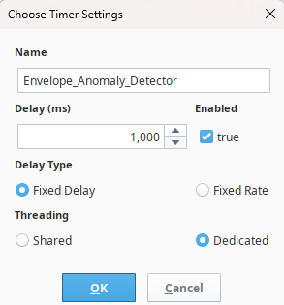
Creating the Timer Scripts
Next we must create the detector timer script.
In “Gateway Events” create a timer script with the following specifications:
Setting | Value
Name | Envelope_Anomaly_Detection
Delay | 1,000ms
Enabled | True
Delay Type | Fixed Delay
Threading | Dedicated

Slide 14
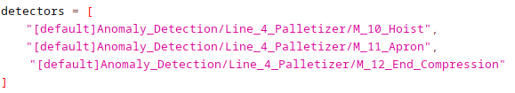
Creating the Timer Scripts
Paste the “Timer_Script.py” file into the timer script.
Next enter the paths to the UDTs of the servos you are monitoring within the “detectors” list as shown in the example below.
As many UDTs as necessary may be entered into this list.

Slide 15
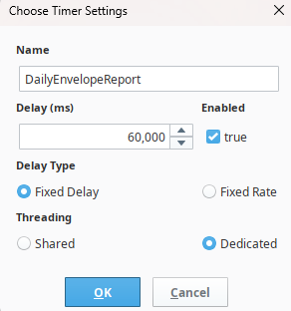
Creating the Timer Scripts
Next, we will create the reporting scripts. Create two scripts. Each with the same following settings with the names of “DailyEnvelopeReport” and “WeeklyEnvelopeReport” respectively.
These will automate the process of sending daily and weekly reports straight to your email.
Paste the scripts found in the GitHub and your reports are now automated.
Setting | Value
Delay | 60,000ms
Enabled | True
Delay Type | Fixed Delay
Threading | Dedicated

Slide 16
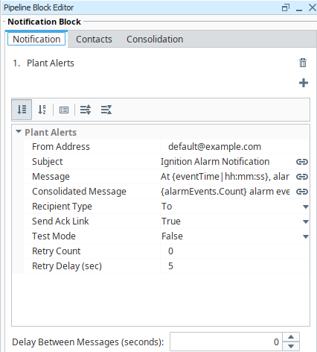
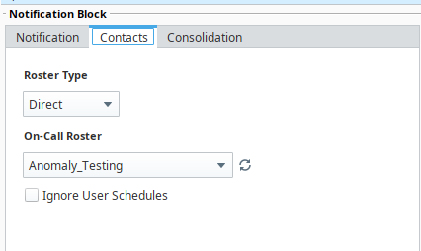
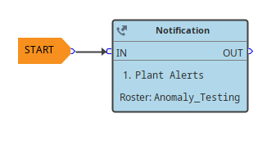
Alarm Configuration
Notification Pipeline
Create a notification pipeline, roster, and email profile to allow for notification of alarms to be delivered to interested recipients.

Slide 17
Alarm Configuration
Hour_Alarm – Notification Alarm
On Hour_Alarm in the UDT, create an alarm with the following settings.
This will be the notifying alarm for envelope excursions.
Setting | Value
Enabled | True
Mode | Equal
Setpoint | 1
Active Delay | 0
Clear Delay | 0
Active Pipeline | Notification pipeline of your choice

Slide 18
Alarm Configuration
Hourly_Alert_Pulse – Journal-only Alarm
On Hourly_Alert_Pulse in the UDT, create an alarm with the following settings.
The pulse alarm must not use the notification pipeline. Its purpose is to create one Alarm Journal event for each qualifying completed clock hour.
Setting | Value
Name | Hourly_Envelope_Event
Enabled | True
Mode | Equal
Setpoint | 1
Active Delay | 0
Clear Delay | 0
Active Pipeline | Blank
Clear Pipeline | Blank
Ack Pipeline | Blank

Slide 19
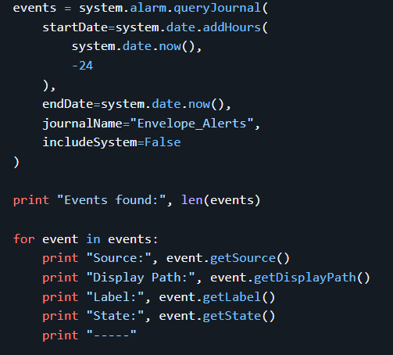
Alarm Configuration
Alarm Journal
The dedicated Alarm Journal is named: Envelope_Alerts
The exact Ignition source format resembles:
Journal filtering should be tested against newly generated alarm events. If a configured journal filter prevents events from appearing, leave the journal filter blank and filter the results in envelopeReports. This is safer than silently dropping anomaly history.
To inspect the journal from the Script Console:
prov:default:/tag:Anomaly_Detection/Line_4_Palletizer/M_12_End_Compression/Hour_Alarm:/alm:Env_Excursion

Slide 20
Adding Another Servo
Create another detector UDT instance
Configure Servo_Actual_Value, SERVO_MIN, and SERVO_MAX.
Set Tolerance_Percent, Window_Seconds, Sample_Interval_Seconds, Min_Outside_Samples, and Min_Alert_Minutes.
Add the instance path to the Gateway Timer Script's detectors list.
Confirm all input/reference tags have Good quality.
Confirm Detector_Status, Outside_Count, Rolling_Alarm, Hour_Outside_Count, and Hour_Alarm update.
Confirm Last_Hour_Key initializes and Current_Hour_Outside_Count increments once per abnormal completed minute.
Confirm a qualifying completed hour causes Hourly_Alert_Pulse to transition false → true → false.
Confirm Hourly_Envelope_Event appears in Envelope_Alerts.
Confirm reports group the event under the exact servo UDT instance.

Slide 21
Reporting
The envelopeReports Project Library script provides four report views:
envelopeReports.getCurrentDayReport()
envelopeReports.getWeekToDateReport()
envelopeReports.getDailyReport()
envelopeReports.getWeeklyReport()
Function | Current Period | Comparison Period
getCurrentDayReport() | Today from midnight through now | Yesterday through the same time
getWeekToDateReport() | Current Monday through now | Previous Monday through the equivalent weekday and time
getDailyReport() | Latest completed calendar day | Calendar day immediately before it
getWeeklyReport() | Latest completed Monday-Sunday week | Completed Monday-Sunday week immediately before it

Slide 22
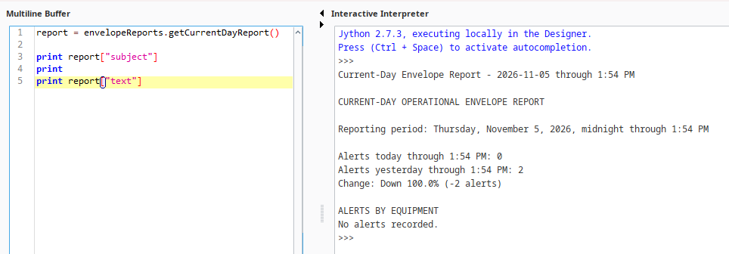
Current Day Report
Compares today from midnight through the current time versus yesterday from midnight through the same elapsed time.
Example from script console:

Slide 23
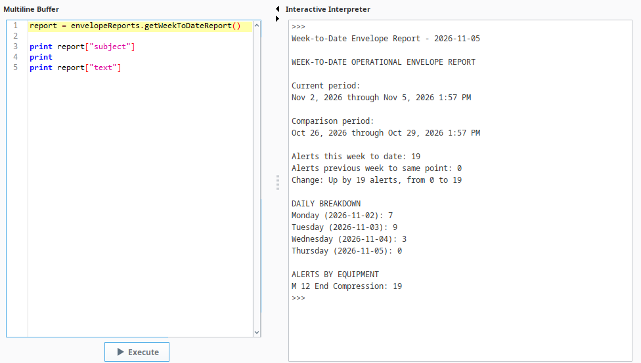
Week to Date Report
Compares the current week from Monday at midnight through the current date and time against the equivalent elapsed period in the previous week.
The result includes:
Total alerts this week to date
Total alerts during the same elapsed period last week
Percentage or absolute change
Daily counts for each elapsed day of the current week
Alert counts grouped by exact servo UDT instance

Slide 24
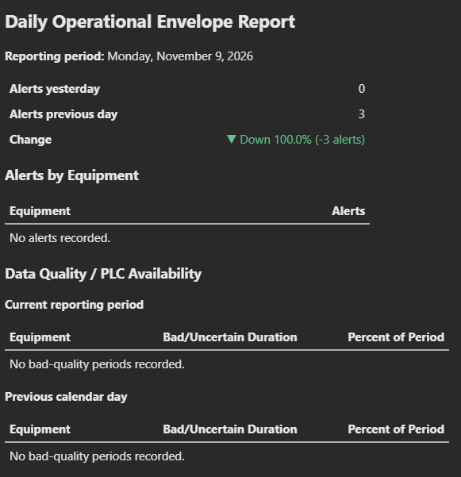
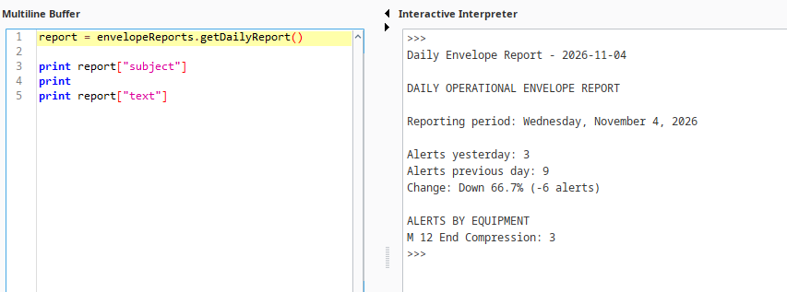
Daily Report
Compares yesterday (the previous completed day) against the day before yesterday.

Slide 25
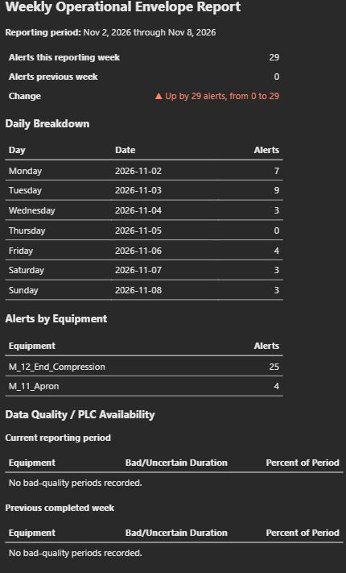
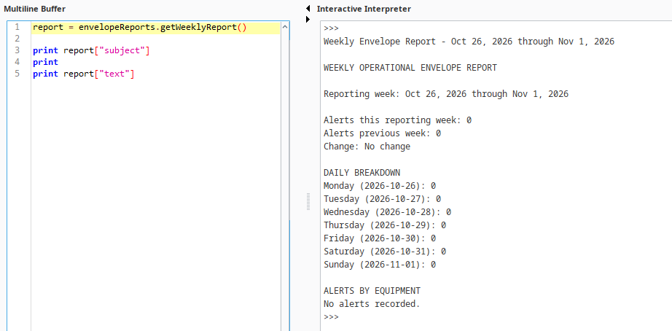
Weekly Report
Compares the latest completed Monday-Sunday week against the completed week before it and includes a seven-day breakdown.

